Slide 1
Spatial-temporal Distribution and
Regulatory Mechanism of Novel Biomarker
Microbial Pterins in Xiamen Bay
Kang Mei (梅 康), Deli Wang (王德利) *
meikang168@xmu.edu.cn
The 15th
October 2023
— Hongkong —

Slide 2
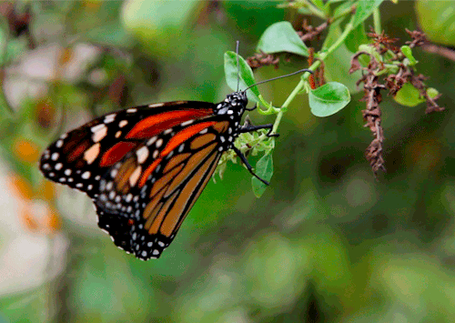
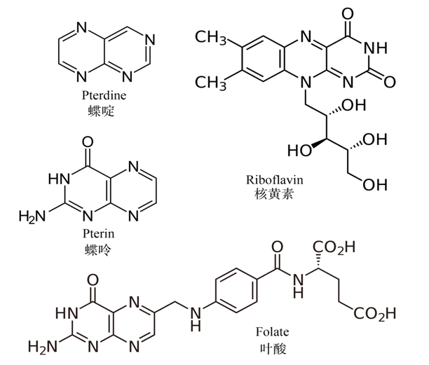
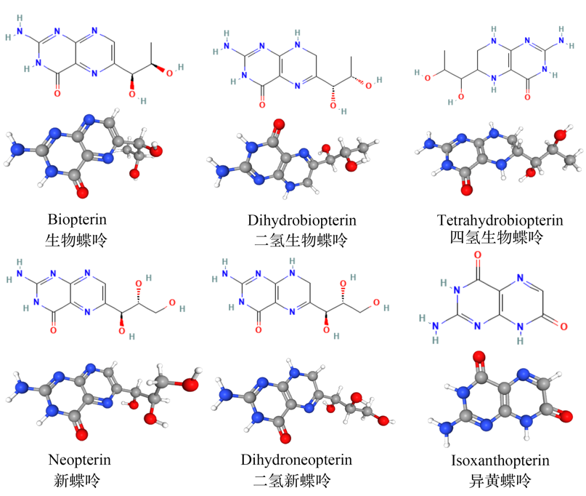
Background of pterin (蝶呤)
⦁ Basic structures
⦁ Vital pterins
VB2
VB9
De novo synthesis
Guanosine triphosphate (GTP)
(Modified form https://pubchem.ncbi.nlm.nih.gov )
Pterins : two nitrogen rings of formed pteridine derivatives, the synthetic precursor of folic acid and vitamin B2.
Biomarkers for detecting cancer, tumors, HIV and other diseases in medical applications.
Neopterin is the precursor to biopterin, and reduced forms of pterins are important coenzyme factors.

Slide 3
Pterin biosynthesis and biological functions
3
⦁ Last Universal Common Ancestor (LUCA)
⦁ Basic biological functions of pterins
Intermediates
Coloration
Cofactors
Vitamins
UV absorption
The place of origin of life
(William Martin & Michael J Russell, 2016)
Carbon and energy metabolism pathways in prebiotic period
Pterins are widespread in in most living organisms.
Diverse and complex functions, but many of them remain unknown.
Notes:
2016年，确认了可能存在于LUCA中的355个基因。一共测序了来自细菌和古菌的610万组原核生物基因，从286,514个蛋白簇中确定了355个可能存在于LUCA的蛋白簇。研究结果表明LUCA是嗜热厌氧生物，具有伍德－隆达尔代谢途径，可以固氮、固碳。其辅因子表明LUCA以来富含氢气、二氧化碳、铁和过渡金属的环境。其遗传物质可能是DNA，需要由4种核苷酸组成的遗传密码、信使RNA、转运RNA和核糖体以将遗传信息翻译为酶等蛋白质。LUCA可能生活在无氧的海底热泉附近，地球化学活动活跃。显然LUCA是一个复杂的生物体，且一定有前身，不是第一个生物。
新蝶呤是生物蝶呤的合成前体，还原型生物蝶呤是非常重要的辅酶因子，参与氨基酸羟基化，一氧化氮合成，维持微生物细胞生长等重要功能。异黄蝶呤则是新蝶呤和生物蝶呤最终代谢产物。生物蝶呤是目前研究关注最多的蝶呤之一。

Slide 4
Research on microbial pterins
4
⦁ Widely spread in Bacteria
⦁ Biopterin in Cyanobacteria
Cyanobacteria
Synechococcus
Anacystis
Nostoc
Spirulina
Anabaena
Oscillatoria
(Yanting Zuo et al., 2022)
Chlorobium limicola & Chlorobium tepidum
Glowing bacteria
Cyanobacteria present a large amount of biopterin and their derivatives.
In the eutrophic water, cyanobacterial biopterin is as high as 1~10 nM.
Released into natural waterbodies and photodegradation under UV/V light
Photosynthetic green sulfur bacteria
Heterotrophic bacteria
Notes:
蝶呤小分子是重要的生物着色物质、辅酶因子、色素分子、构成必需维生素，参与碳氮循环和能量代谢。
Biopterin can be released into natural water bodies and photodegradation occurs under ultraviolet or visible light.

Slide 5
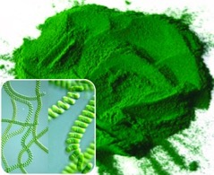
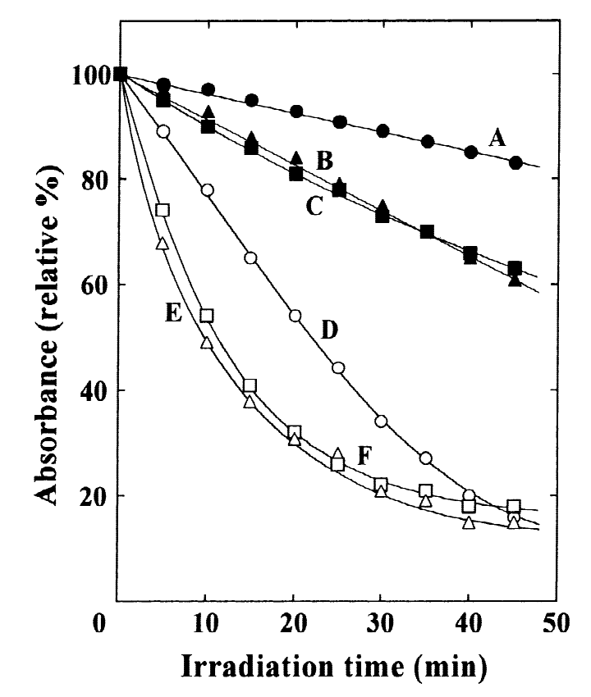
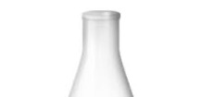
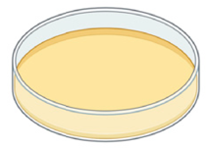
Biological functions of pterins in cyanobacteria
5
⦁ Biopterin glucoside (BPT-α-Glu) protects against UV radiation (254 nm)
(Yukinori et al., 1999)
+ BPT-α-Glu
Chlorophyll-a
﻿Fluorescent substance
﻿ 10 g Spirulina platensis
4.5 mg BPT-α-Glu
Phycocyanin
(Yong Kee et al., 2001)
Carotenoid
敲除BGluT基因
UV
聚球藻
— BPT-α-Glu
. . .
killed
+ BPT-α-Glu
Wild type
Mutant
﻿Escherichia coli Surviving
﻿ The content of biopterin is only 8.3%with half of biomass.
Act as a growth factor to promote microbial growth
Resists the damage of pigments by ultraviolet radiation (UV)
Improve energy capture efficiency of photosynthetic pigments with biopterin
(Yukinori et al., 1999)
Notes:
在海洋蓝藻中检测到的生物蝶呤-糖苷，根据它们的吸收光谱和它们的细胞水平在紫外线- a辐射下增加，它们被赋予了紫外防护作用。
Yukinori 等人发现大肠杆菌（Escherichia coli ）细胞在 254 nm UV辐射中致死，而添加生物蝶呤葡萄糖苷后再进行同样波长紫外辐射能正常存活。
另外在蓝细菌螺旋藻中添加后，叶绿素a/藻青蛋白/类胡萝卜素三种色素吸收值的相对丰度均显著高于未添加组。
在10g螺旋藻 冻干藻粉中提取了4.5mg 蓝色荧光物质的生物蝶呤葡萄糖苷。
the utilization efficiency of photosynthetic pigment energy capture is significantly improved, and it resists the destruction of pigment by ultraviolet rays

Slide 6
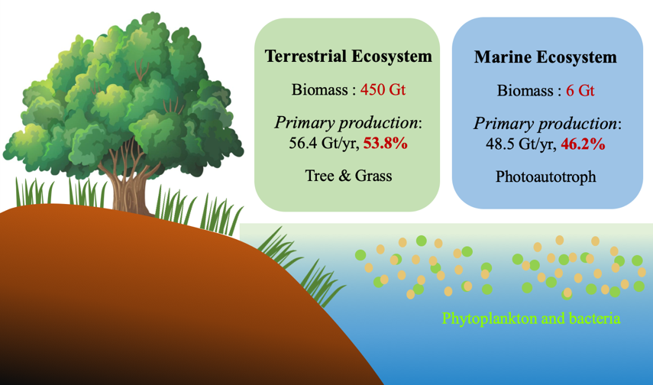
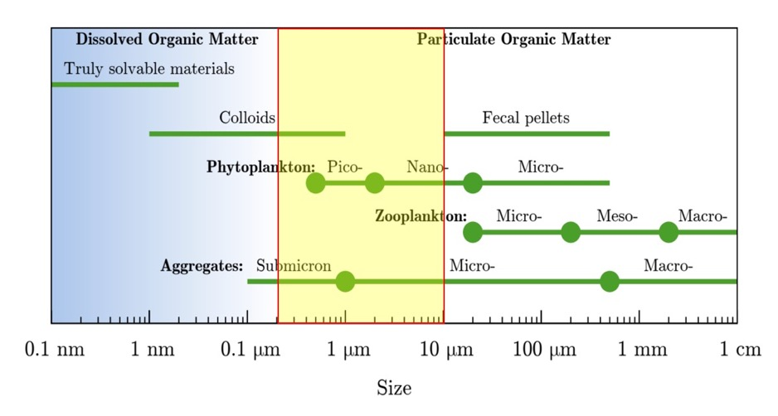
Research background in the marine environment
6
⦁ Marine phytoplankton contribute half of global primary production
Pico & Nanophytoplankton
（0.2-10 um）
⦁ micro-plankton
Bacteria-phytoplankton
(0.2-3 um)
(3-10 um)
Heterotrophs
Free-living
Particle-associated
Focus
(Simon et al., 2002)
Picophytoplankton & Nanophytoplankton are the major components of microphytoplankton.
Small size, large quantity, widely distribution, high productivity; the foundation of marine ecosystems
Notes:
Small size, large quantity, wide distribution, high productivity; It is the foundation for building marine ecosystems

Slide 7
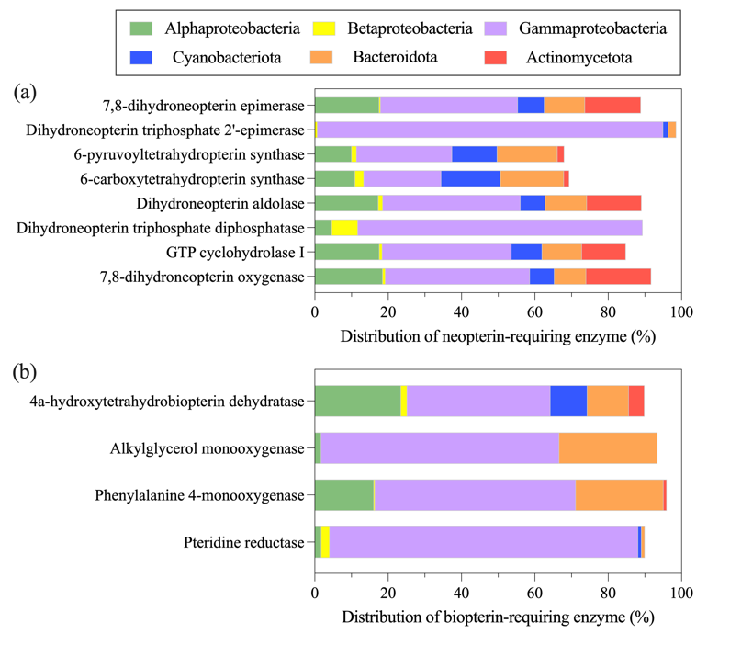
Research status of pterins in the ocean
7
7
⦁ Pterin-enzymes in major marine microbial taxa
⦁ Functional biopterin in marine phytoplankton
(a) Neopterin
(b) Biopterin
Bacteria &
Growth factor
(Mei et. al, Under Review)
NO： Nitric Oxide synthase.
Amino acid： Aromatic amino acid hydroxylase.
Glucose： Biopterin Glucosyltransferase.
Notes:
新蝶呤酶在变形菌门和蓝细菌中广泛分布

Slide 8
Research status of pterins in the ocean
8
⦁ Relate to the origin of life and key metabolic small molecules
⦁ Determination of a variety of microbial pterins in the marine environment has only been reported rarely.
⦁ Diverse and widely distributed and in marine
microorganisms (cyanobacteria)
⦁ Limited to a single pterins or special sample in the ocean.
⦁ Pigments, cofactors, signaling molecules, growth factors, etc.
⦁ Composition and spatial and temporal distribution of pterotropin in different marine environments are still gap.
⦁ Carbon and nitrogen cycle and energy metabolism and vital
biological significance
Significance
Research Gap
Pterin plays an important role in the growth of marine microplankton
The distribution pattern and regulatory mechanism of biopterin in the marine environment remain unclear.
Research topic: Concentration, distribution of pterins in marine microplankton taxa and its regulatory mechanism

Slide 9
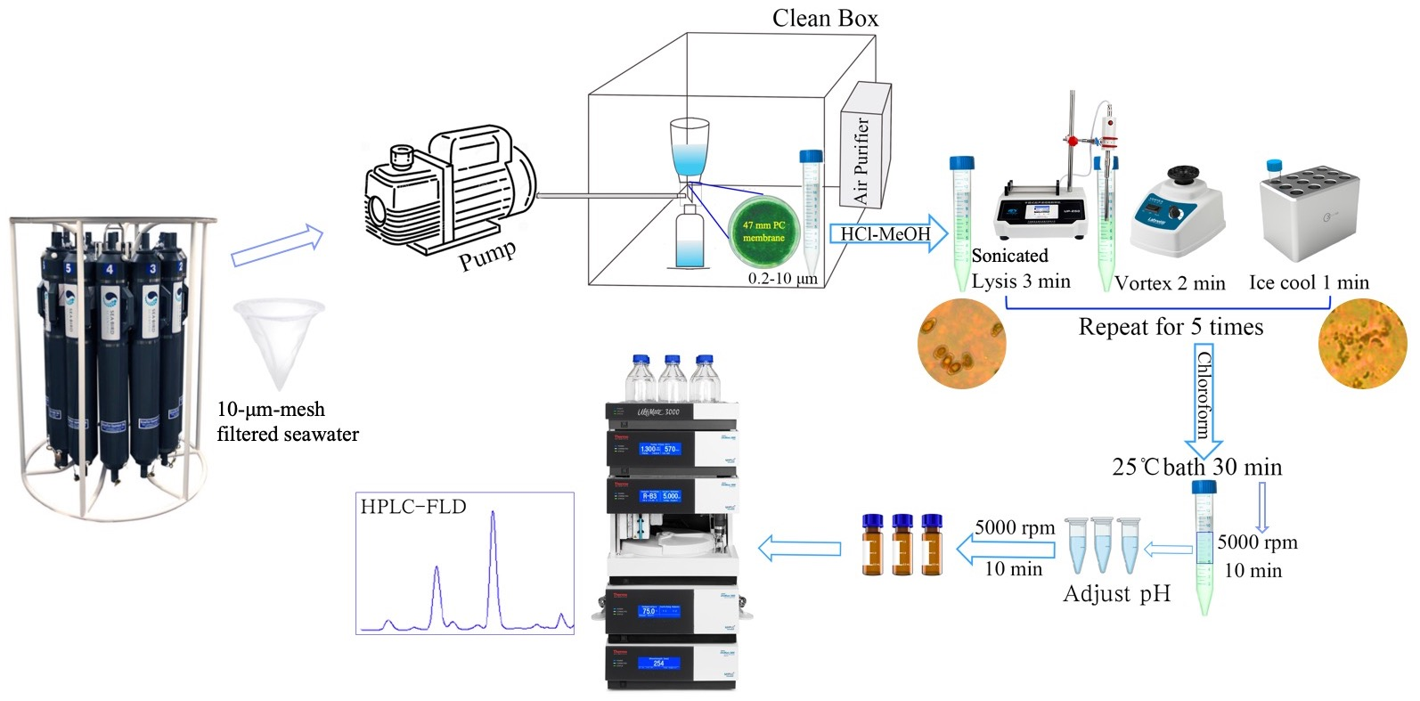
Method establishment and optimization
9
9
⦁ Processing protocol of microbial pterins
Water Sampling
(Suffridge and Sergio, 2017)

Slide 10
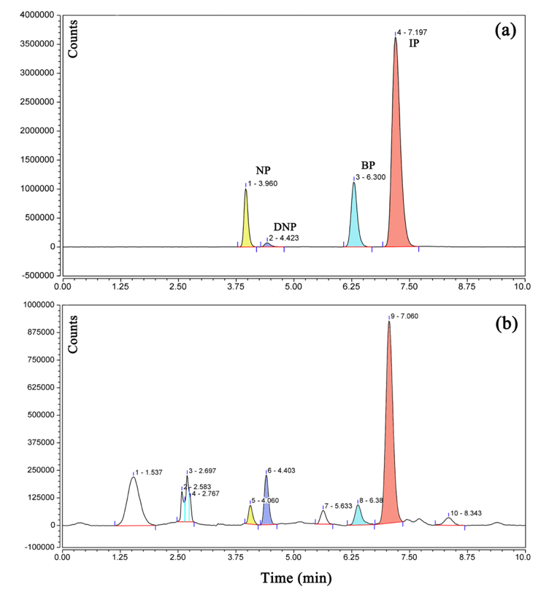
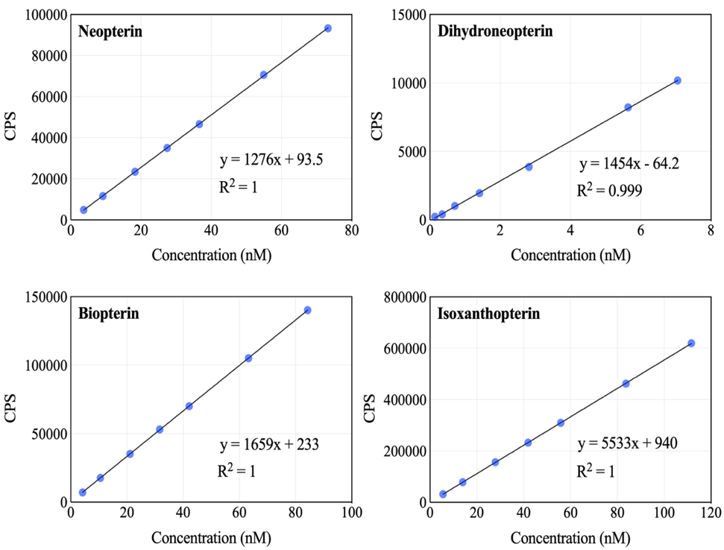
Determination of several pterins via HPLC-FLD
10
10
⦁ Peaks of standard and real sample
⦁ Working Curves of standards
(NP)
(DNP)
(BP)
(IP)

Slide 11
Applied to the marine environment
11
11
⦁ Application results of multiple microbial pterins determination
Sources | Sample | Type | NP | DNP | BP | IP
Sediment Porewater (nM) | 1 mL | XMB Surface sediment | 1.51-48.8 | 0.83-184.3 | 0.38-20 | 2.1-11.9
Coastal waterbody (pM) | 150 mL | XMB Flood season | 6.6-31.2 | 0.86-64.4 | 0.23-37.6 | 2.4-136
 | 150 mL | XMB Dry season | 1.7-8.1 | 0.92-8.8 | 2.01-16.9 | 2.2-9.6
Shallow Hydrothermal vent | 500 mL | Yellow Vent | 0.31-43.7 | 21.3-76.3 | 1.4-3800 | 0.5-16.7
 | 500 mL | White Vent | 2.9-49.6 | 18.2-75.7 | 12.9-124 | 0.03-119
South China Sea | 10 L | Photic zone | BDL | BDL | 0.01-0.6 | 0.01-3
Culture coastal water (pM) | 250 mL | Offshore mesocosm | 1.93-35.4 | BDL | 3.79-78.9 | 1.93-32.1
For the first time, a method for the determination of a variety of pterins in marine microorganisms (particle size 0.2-10 μm) was established.
There were differences in concentrations: sediment porewater (nM) > Estuarine > Hydrothermal > South China Sea (pM).
Notes:
Successfully applied to the quantification of pterin in natural samples such as nearshore sediments, estuarine water bodies, shallow sea hydrothermal fluids and the South China Sea euphotosphere.

Slide 12
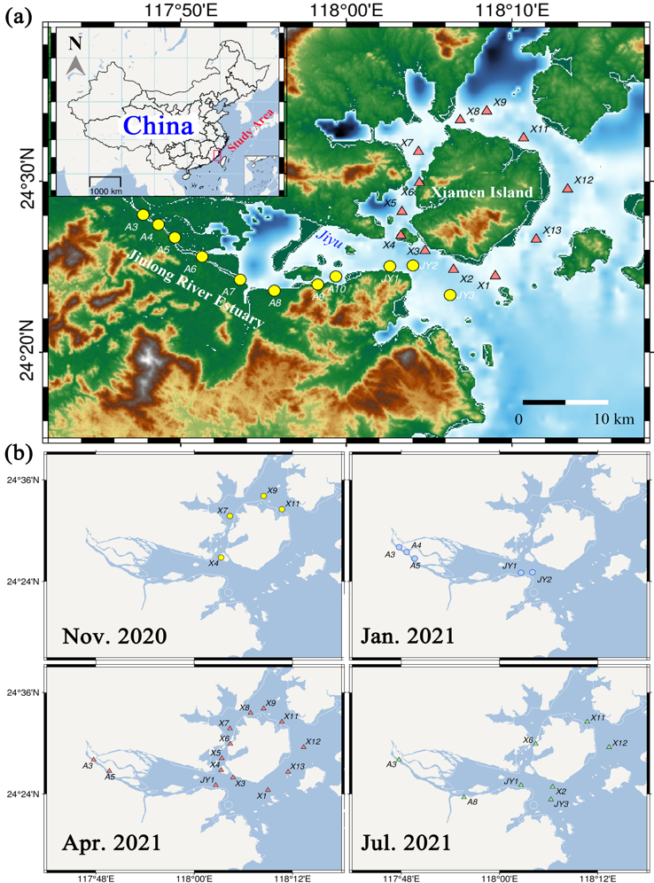
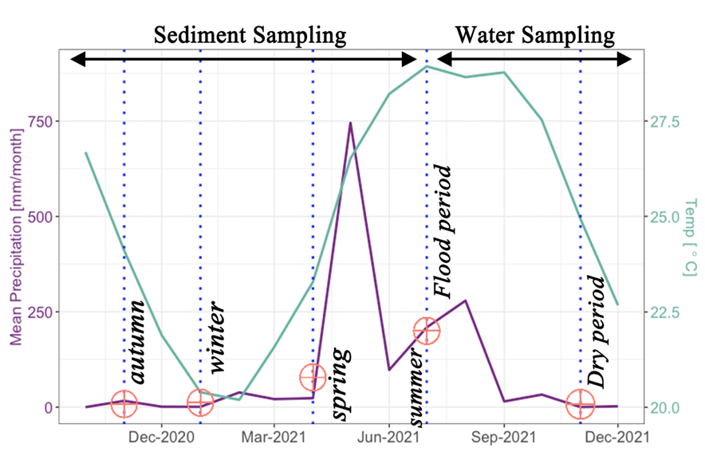
Case study: Pterins in Jiulong River Estuary and Xiamen Bay
12
12
Waterbody
⦁ Average monthly temperature and precipitation
A3
A4
A5
A6
JY2
A7
A10
JY1
A8
A9
JY3
Flood period in summer and Dry period in autumn (Surface and bottom water)
Estuarine-nearshore surface sediment sampling for four consecutive seasons.
Sediment

Slide 13
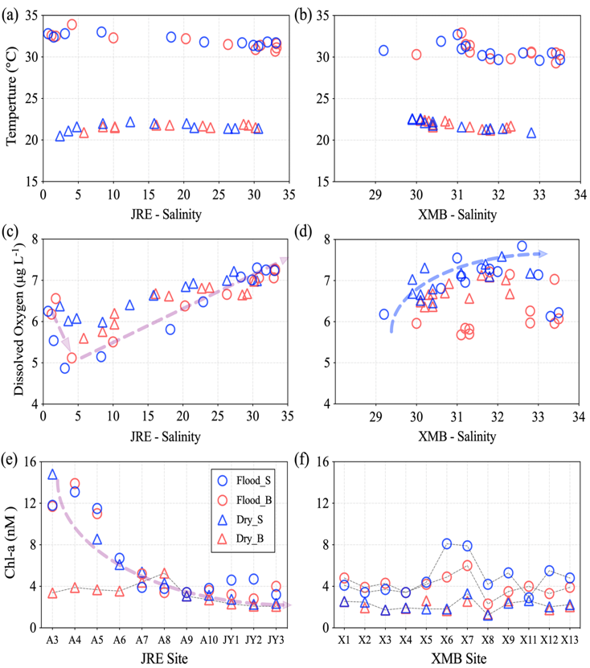
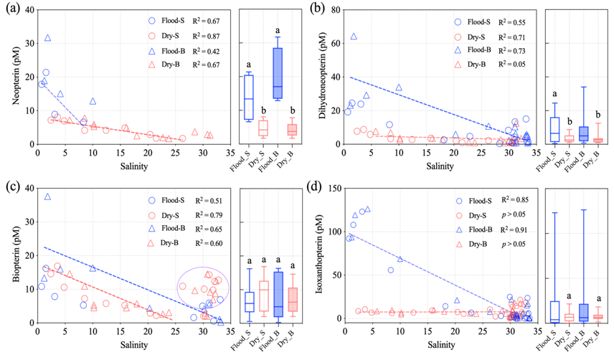
Changes of seawater chemical parameters and pterins
13
13
⦁ T/S, DO and Chl-a
(Data by Prof. Nengwang Chen)
⦁ Distribution of pterin varies with salinity
XMB
⦁ Mean value distribution of the corresponding layer of pterin
 | Summer |  | Autumn
Pterin (pM) | Flood_S | Flood_B | Dry_S | Dry_B
NP | 13.7±7.06A | 19.7±8.43a | 4.66±2.33AB | 4.27±2.10ab
DNP | 9.37±8.63A | 11.8±16.4a | 3.50±2.58B | 3.57±3.20b
BP | 6.68±4.72A | 11.0±11.7a | 8.72±4.90A | 7.35±4.20a
IP | 24.6±39.6A | 27.1±41.7a | 7.62±6.03AB | 7.71±4.54a
Upper
Lower
Inner Bay
Outer Bay
DO decreased first and then increased at JRE, XMB: surface layer > bottom layer
Chl-a ：Flood period > Dry period
Flood period > Dry period（Same as Chl-a）
Flood period: High NP and DNP， Dry period: BP and IP
Bottom layer of flood period : all pterins concentration were high
Notes:
Pterin showed a decreasing trend in the estuary, and the flood period > dry period. The bottom layer of the water harvest period showed that all pterin concentrations were the highest

Slide 14
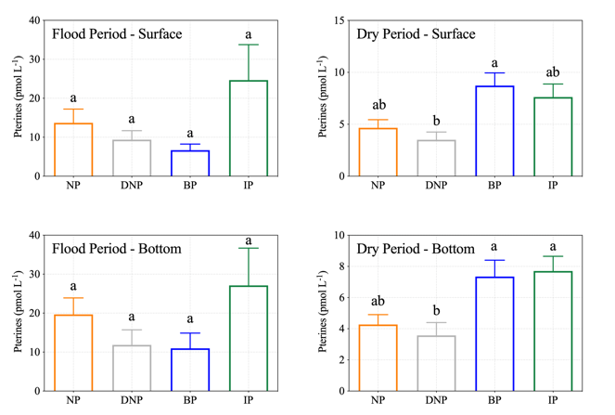
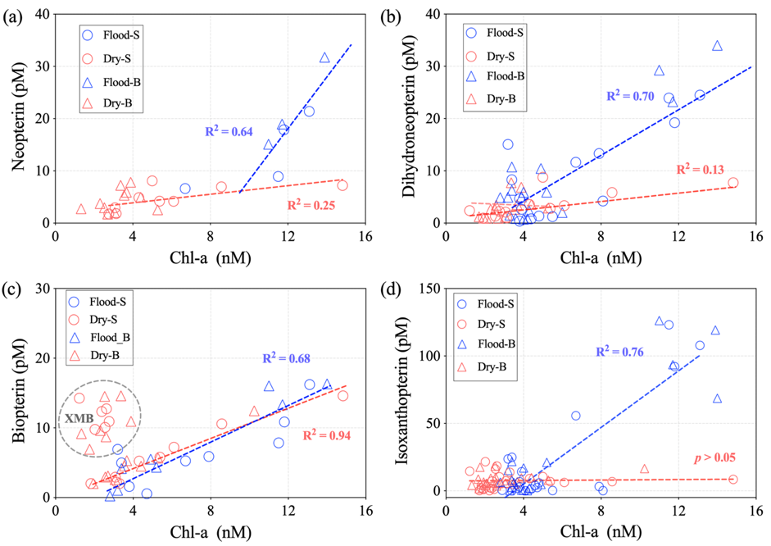
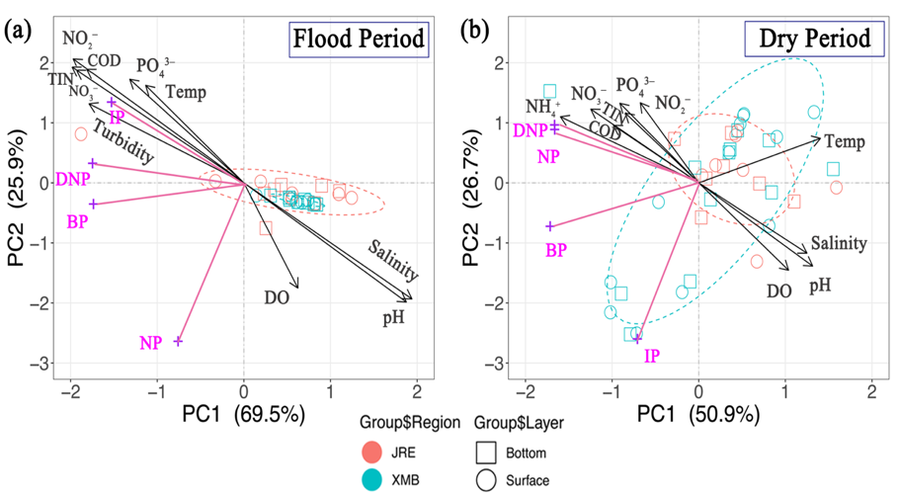
Pterins variations interacted with environmental factors
14
14
⦁ Plot of pterins and chlorophyll a
⦁ Mean pterins
Flood period
Dry period
IP > NP > DNP > BP
BP、IP > NP > DNP
⦁ PCA results
Pterin is linearly positively correlated with Chl-a during flood period
Biopterin showed high value in dry period of XMB, corresponding to low Chl-a.
Notes:
【1】通过分析Chl-a和生源蝶呤的线性关系，结果显示丰水期无论表层还是底层，所有蝶呤均和Chl-a浓度表现为极显著正相关；【2】生物蝶呤在枯水期XMB表现高值，对应低Chl-a值；推测由于枯水期生产力整体降低，而细菌等异养生物成为生源蝶呤的重要来源。
在夏季丰水期表底层蝶呤含量间均无显著性差异，而在秋季枯水期蝶呤间差异性表底各有不同 。夏季丰水期生源蝶呤浓度高低为：IP > NP > DNP > BP，秋季枯水期浓度整体降低，高低顺序表现为：BP、IP > NP > DNP、
PCA结果表明丰水期异黄蝶呤与环境因子表现为显著正相关，枯水期新蝶呤与二氢新蝶呤与环境因子呈显著正相关

Slide 15
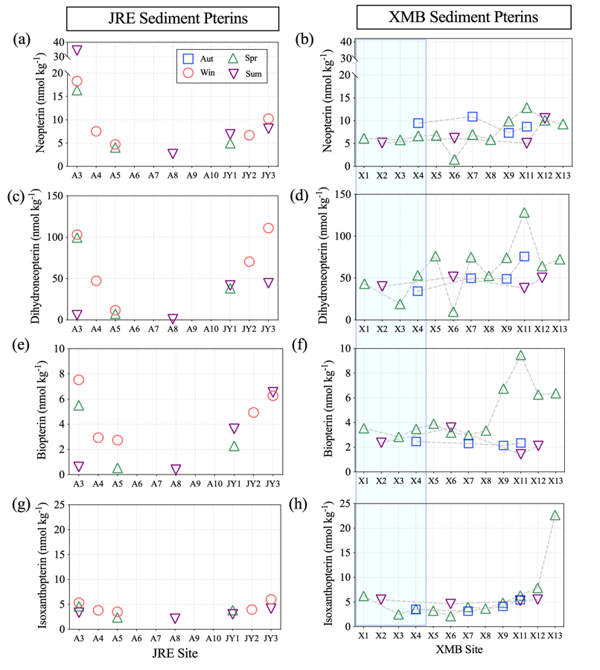
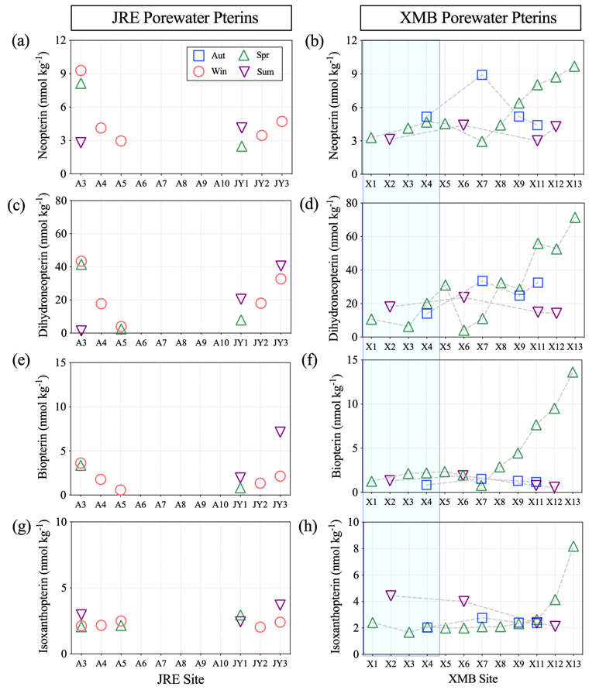
Pterin variations in the sediments and its porewater
15
15
⦁ Pterin distribution in sediments
⦁ Pterin distribution in pore waters
Upper Estuary
Lower Estuary
Inner Bay
Outer Bay
Upper Estuary
Lower Estuary
Inner Bay
Outer Bay
The estuary is with high pterins at both ends and low concent in the middle
Notes:
沉积物中蝶呤分布中，沉积物中生源蝶呤平的均浓度要高于其孔隙水中的蝶呤浓度。河口表现为两端高，中间低。春季XMB的蝶呤高值与藻华爆发有关。

Slide 16
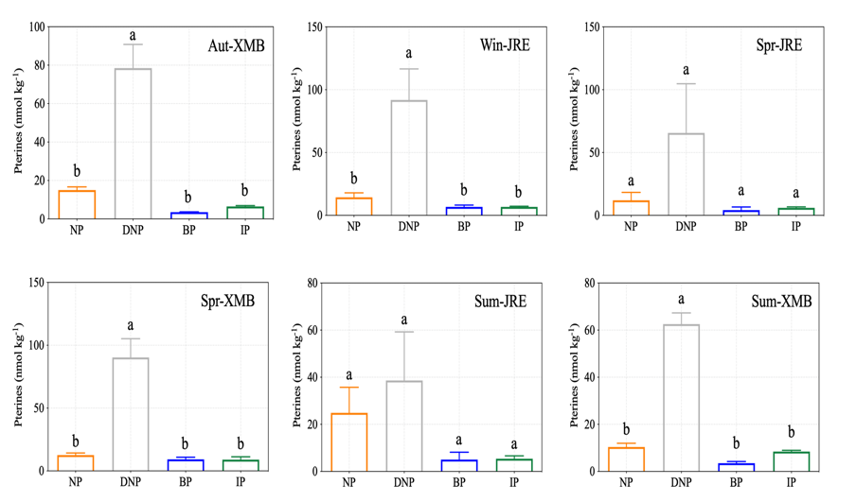
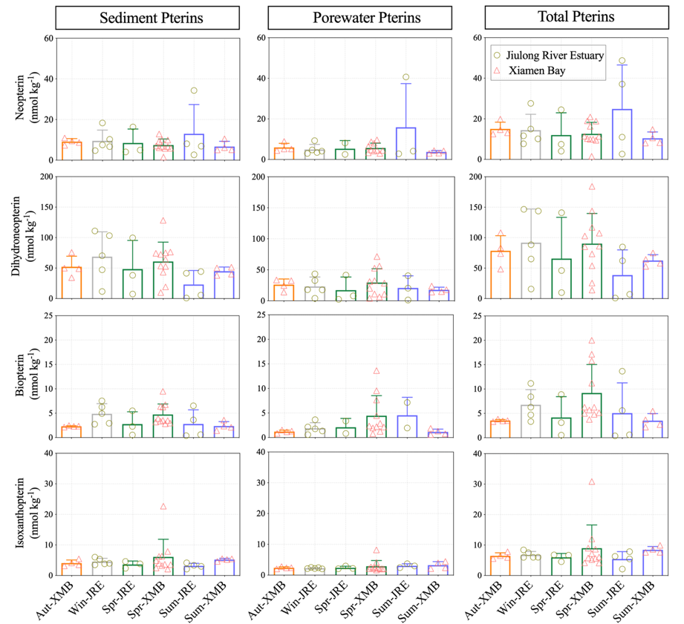
Pterins variations in the sediments and its porewater
16
16
⦁ Mean values of pterins
⦁ Sediment seasonal pterins in total
DNP > NP > BP、IP
 | Sediment | NP: DNP |  | Waterbody | NP: DNP
Autumn | Aut_XMB | 0.19 | Summer | Flood_S | 1.46
Winter | Win-JRE | 0.15
Spring | Spr-JRE | 0.18 | Summer | Flood_B | 1.67
 | Spr-XMB | 0.14 | Autumn | Dry_S | 1.33
Summer | Sum-JRE | 0.65
 | Sum-XMB | 0.16 | Autumn | Dry_B | 1.19
Ratio range |  | 0 < R < 1 |  |  | 1 < R < 2
There was no significant difference of each pterin between seasons.
Reduced dihydroneopterin predominated in sediments.
The NP/DNP ratio can indicate the redox state of waterbody or sediment
Notes:
所有季节沉积物蝶呤浓度大小顺序均表现为：DNP > NP > BP、IP。还原型二氢新蝶呤（44-60.8 nmol kg⁻¹）总量总体比生物蝶呤（5.0-9.5 nmol kg⁻¹）要高一个数量级，新蝶呤和二氢新蝶呤的含量比例变化可以指征水体或沉积物的氧化还原状态 。

Slide 17
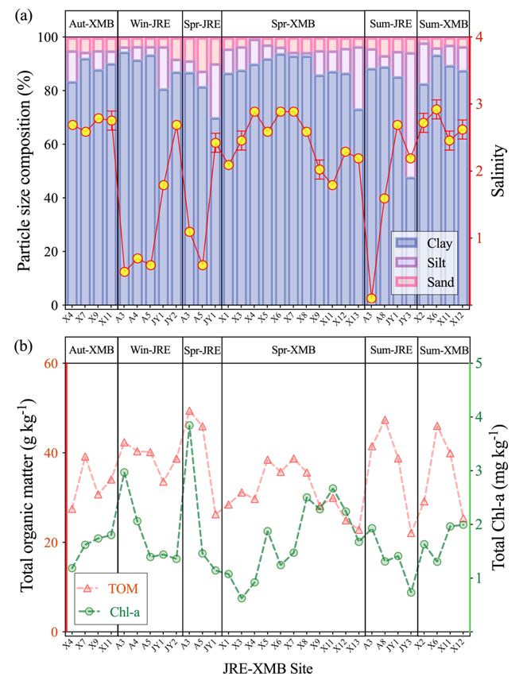
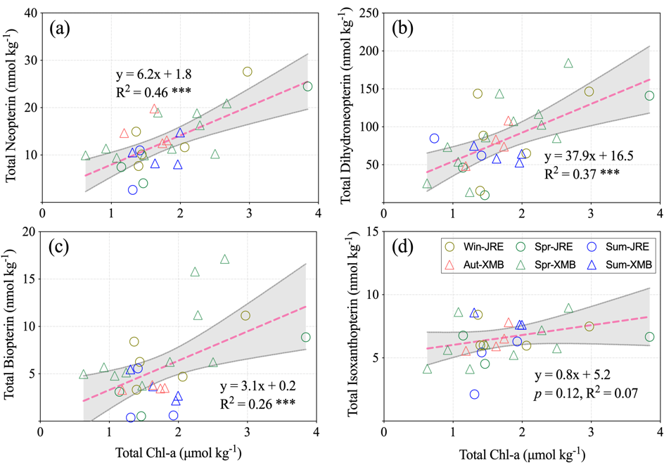
Pterins variations interacted with sediment properties
17
17
⦁Sediment particle size, TOM and chl-a characteristics
⦁ Plot of total pterins and Chl-a in sediments
The sediments were dominating by clay components.
Total organic matter distribution is similar to Chl-a except in summer.
Except for IP, other pterins are significantly positively correlated with Chl-a.
(Mei et. al, In Preparation)

Slide 18
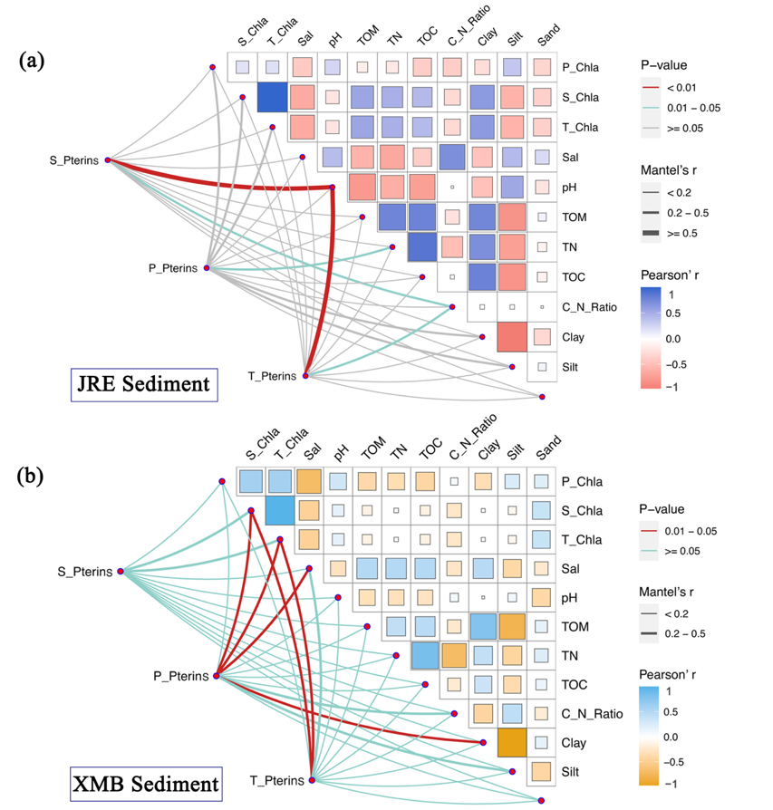
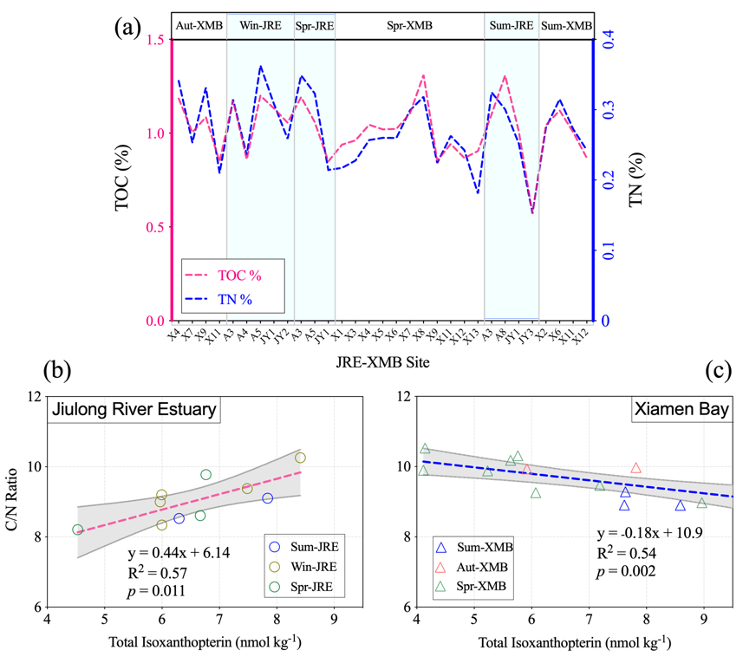
Pterins variations interacted with sediment properties
18
18
⦁ Relationship between sediment C&N content and IP
Sediment C & N : High in upper estuary；TOC correlated with TN
JRE：IP positively correlated with C/N；XMB： negative correlation
pH and N content are dominant in the JRE, while Chl-a is dominant in the XMB.
(Mei et. al, In Preparation)
Notes:
The contents of sediment C and N were high in the upper reaches of the estuary. TOC and TN were significantly positively correlated.

Slide 19
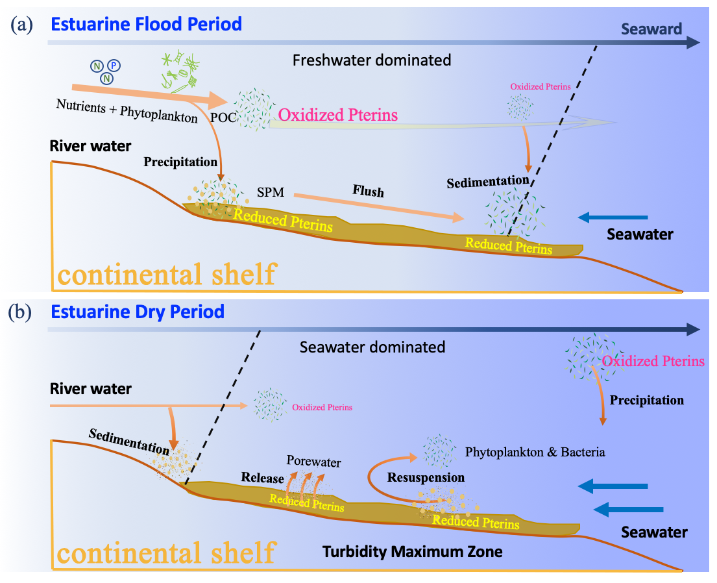
Conceptual summary of estuarine-nearshore microbial pterins
19

Slide 20
Take home messages
20
(1)
Pterin is ubiquitous in the coastal marine environment, but the composition and abundance of pterins concentration of different microorganisms are different.
(2)
Estuarine waters contribute more phytoplankton-derived pterins (biopterin: BP and isoxanthoterin: IP), and sediments contribute a higher proportion of reduced pterin (dihydroneopterin: DNP).
(3)
The concentration of pterins were different due to the abundance and composition of microorganisms in different habitats, which could be used as potential biomarkers. Sediments tend to generate reduced DNP and its precursor neopterin (NP), but aqueous marine environment are more likely to retain BP and final product IP.
(4)
Reduced DNP (44-60.8 nM) in sediment porewaters was 3-10 times that of other pterins, but there is no significant difference in the distribution of pterins between seasons, mainly due to bacterial decomposition in the sediment, and biodegradation as supplementary sources of microbial pterins.

Slide 21
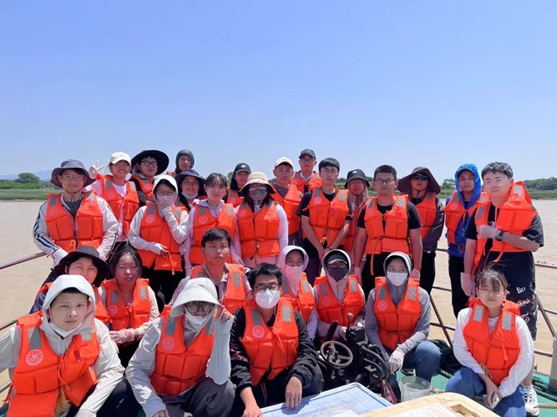
05
The 15th UCAS
05
Acknowledgements
PI: Prof. Deli Wang RA: Xinli Yue Me Lide Gu
Liuqian Qi Haowen Zhong Wenmei Liu Yuanshuai Qiao
Research Vessel : Haiyang II

Slide 22
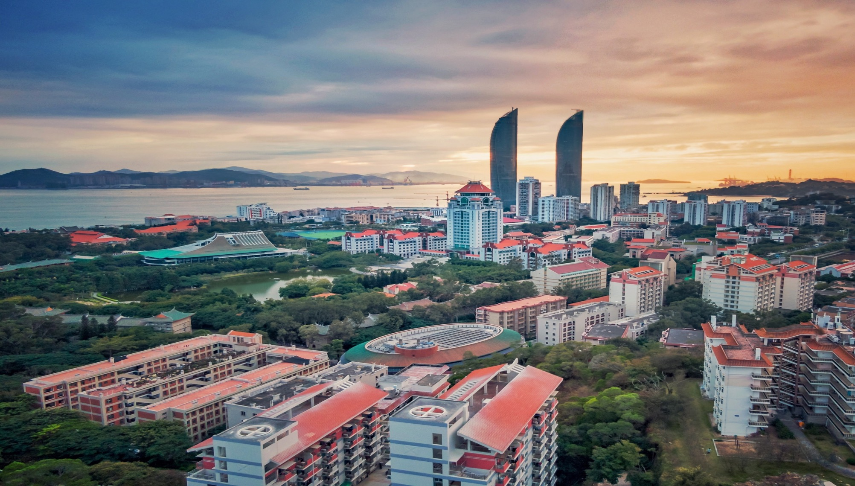
Thanks For Your Attention!
meikang168@xmu.edu.cn

